Slide 1





Team Name: SkyTronix
Problem Number: 9
Problem Statement: Engineering a drone that can establish temporary communication networks in disaster struck regions

Slide 2
Solution Proposed:
We propose an AI-powered drone swarm that establishes a rapidly deployable, ad-hoc communication network over disaster zones.
Each drone, carrying a cellular or Wi-Fi payload, is part of an intelligent, self-healing mesh network managed by AI.
The AI dynamically positions the swarm for optimal coverage and adapts to the mission, while a satellite backhaul provides global internet connectivity.
This restores vital communication for survivors and first responders when terrestrial infrastructure is destroyed.

Slide 3

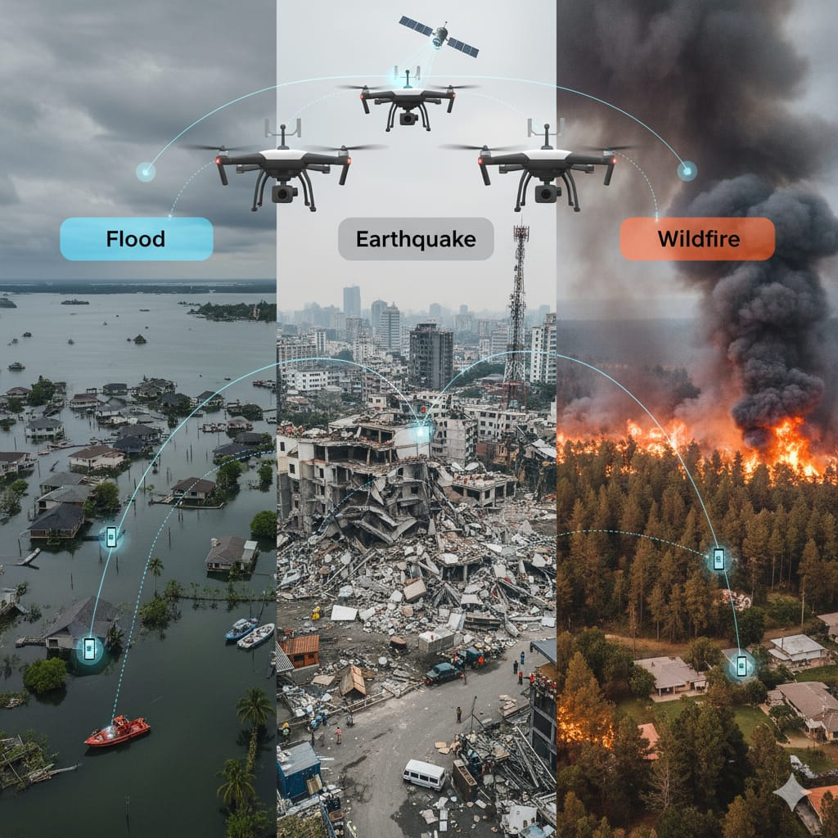


Image Created

Slide 4
Features and keypoints
The drone-and-satellite-based disaster management system ensures real-time monitoring and faster decision-making during emergencies.
It provides continuous communication even when local networks fail.
Drones can reach inaccessible or high-risk areas quickly for rapid assessment.
This leads to efficient coordination and quicker rescue operations.

Slide 5
Advantages over existing Products
The system offers high accuracy, safety, and cost-effectiveness compared to traditional methods.AI-equipped drones identify survivors and assess damage with precision.It reduces risks to human responders through remote surveillance.Overall, it enables a predictive, scalable, and technology-driven disaster response.

